Slide 1

Data Analytics Report
Customer Shopping
Behavior Analysis
Data-Driven Insights for Strategic Business Decisions
Dataset
Features
Comprehensive Analysis
3,900 Transactions
18 Dimensions
Python • SQL • Power BI

Slide 2
Navigation
Executive Overview
Five key sections covering the complete customer behavior analysis journey
01
Project Overview
02
Dataset & Methodology
Understanding the scope, objectives, and business context of the customer behavior analysis initiative.
Exploring the data architecture, quality, and our three-layer analytics approach using Python, SQL, and Power BI.
03
Key Insights
04
Segmentation Findings
Revenue patterns, customer segments, product performance, and behavioral trends revealed through data analysis.
Customer classification into New, Returning, and Loyal segments with lifecycle management insights.
05
Strategic Recommendations
Five actionable pillars for growth: subscription optimization, loyalty programs, pricing strategy, product positioning, and targeted marketing.

Slide 3
Section 01
Project Overview: Unlocking Customer Insights
Project Mission
This comprehensive analysis examines 3,900 customer transactions across multiple product categories to uncover actionable insights into spending patterns, customer segments, product preferences, and subscription behavior.
Data Scale
Our goal is to transform raw transactional data into strategic business intelligence that guides marketing decisions, pricing strategies, and customer experience optimization.
Total Transactions
3,900
Data Features
18
Spending Patterns
Customer Segments
Analyze purchase amounts, frequency, and seasonal trends
Identify New, Returning, and Loyal customer groups
Data Quality
99.05%
Product Preferences
Subscription Behavior
Discover top-rated and best-selling products by category
Compare subscriber vs. non-subscriber value and loyalty
Key Outcome
Deliver actionable insights for strategic business decisions across marketing, pricing, and customer experience optimization.

Slide 4
Section 02
Dataset Architecture
18 Dimensions of Customer Behavior
Customer Demographics
Shopping Behavior
Age & Age Groups
Gender Classification
Discount Applied
Boolean flag for promotional pricing
Previous Purchases
Location Data
Subscription Status
Historical transaction count
Purchase Frequency
Shopping interval patterns
Purchase Details
Review Rating
Customer satisfaction scores
Item
Category
Amount
Shipping Type
Standard vs. Express delivery
Season
Size
Color
Data Quality
Missing Values
37 (0.95%)
Imputation Method
Median by Category
99.05% Complete Data

Slide 5
Section 02
Methodology: Three-Layer Analytics Approach
01
Python EDA
02
SQL Analysis
03
Power BI
Data Preparation & Feature Engineering
Business Intelligence Queries
Interactive Visualization
Data Loading
1
Revenue by Gender comparison
Dashboard Creation
Imported dataset using pandas, initial exploration with df.info() and .describe()
Built interactive dashboard presenting insights visually for stakeholders
2
High-spending discount users identification
Data Cleaning
3
Top 5 products by rating analysis
Handled 37 missing values in Review Rating using median imputation by category
Dynamic Filtering
4
Shipping type comparison (Standard vs Express)
Enabled drill-down capabilities by category, segment, and time period
Feature Engineering
5
Subscribers vs Non-subscribers analysis
Created age_group column and purchase_frequency_days for deeper analysis
Executive Reporting
6
Discount-dependent products identification
Designed for clear, actionable insights delivery to decision-makers
7
Customer segmentation (New/Returning/Loyal)
Database Integration
Connected to PostgreSQL and loaded cleaned data for SQL analysis
8
Top 3 products per category
9
Repeat buyers & subscription correlation
Comprehensive analytics pipeline from raw data to strategic insights
10
Revenue by age group calculation

Slide 6
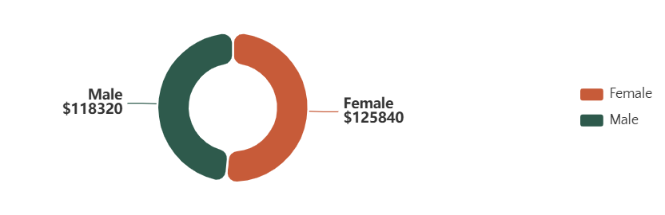
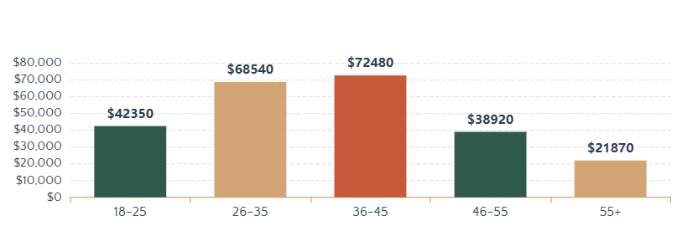
Section 03
Revenue Insights
Gender & Age Group Analysis
Revenue by Gender
Key Findings
Gender Distribution
Comparative analysis reveals spending patterns between male and female customers, informing gender-targeted marketing strategies.
Age Group Value
Total revenue contribution varies significantly across age demographics, highlighting high-value segments for focused campaigns.
Revenue by Age Group
Strategic Implications
Targeted Marketing: Focus efforts on high-revenue demographics
Product Positioning: Align offerings with segment preferences
Budget Allocation: Optimize spend based on revenue potential
Understanding revenue distribution across demographics enables precise targeting and maximizes marketing ROI.

Slide 7
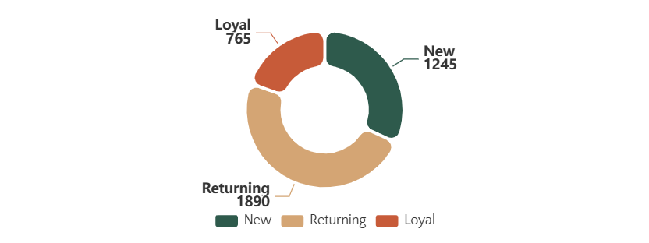
Section 04
Customer Segmentation
From New Buyers to Loyal Advocates
Segmentation Framework
Customer Distribution
N
New Customers
1,245
First-time purchasers with 1 transaction. Focus on onboarding and engagement to drive repeat purchases.
R
Returning Customers
1,890
Customers with 2-5 purchases. Nurture with personalized offers to increase purchase frequency.
L
Loyal Customers
765
Subscription Correlation
Key Insight
VIP customers with 5+ purchases. Reward with exclusive benefits and early access to maintain loyalty.
Customers with 5+ purchases show significantly higher subscription likelihood, validating the loyalty program approach.
Customers with 5+ Purchases
68%
Subscription Rate
Focus on moving Returning customers to Loyal segment
Customers with <5 Purchases
32%
Subscription Rate

Slide 8
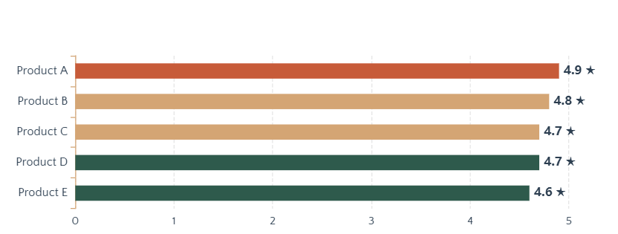
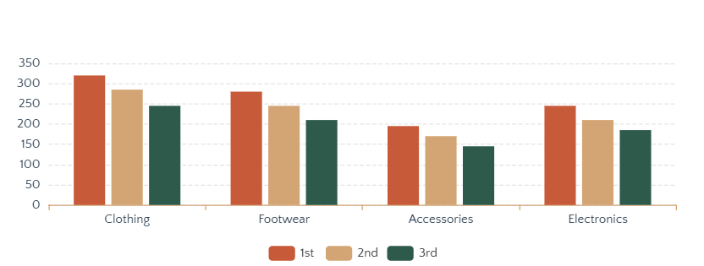
Section 03
Product Performance
Top-Rated & Best-Selling Items
Top 5 Products by Average Rating
Discount-Dependent Products
Products with highest percentage of discounted purchases requiring pricing strategy review:
Product A
78%
Product B
72%
Product C
65%
Top 3 Products per Category (Purchase Volume)
Product D
61%
Product E
58%
Strategic Actions
Promote Top-Rated: Feature in marketing campaigns
Review Pricing: Balance discounts with margins
Cross-Sell: Pair bestsellers with related items

Slide 9
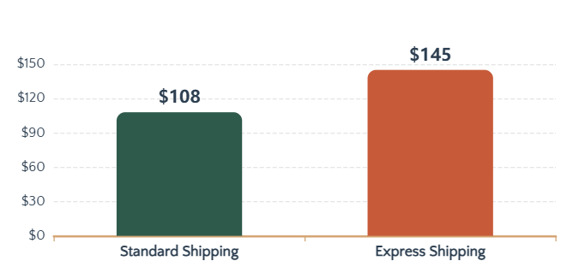
Section 03
Subscription & Shipping Behavior
Value Analysis & Premium Service Insights
Subscribers vs Non-Subscribers
Shipping Type Comparison
Subscribers
1,456 customers
Avg Spend
Total Revenue
$142
$206,752
Non-Subscribers
2,444 customers
Avg Spend
Total Revenue
Strategic Insights
$98
$239,512
Subscription Value: Higher average spend justifies exclusive benefits
Express Shipping: Premium service users show higher purchase values
Upsell Opportunity: Target non-subscribers with subscription benefits
Subscribers spend 45% more on average
Key Takeaway: Premium services (subscriptions & express shipping) correlate with higher customer value and loyalty.

Slide 10
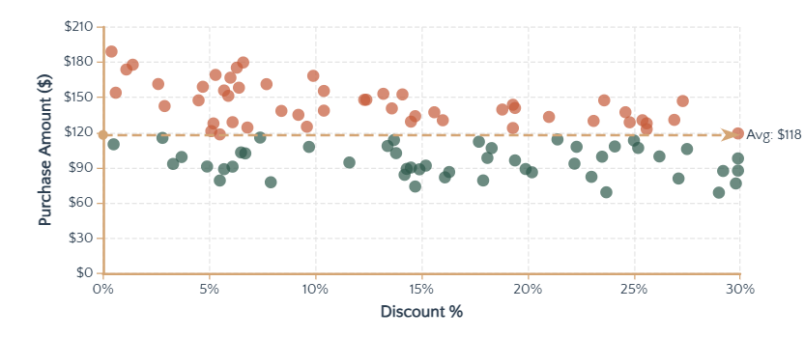
Section 03
Discount Strategy Analysis
High-Spending Discount Users
High-Value Discount Segment
Discount Usage vs Purchase Amount
Analysis identifies customers who used discounts but still spent above average purchase amounts. This segment represents a unique opportunity—price-sensitive yet high-value customers.
Segment Size
Avg Purchase
847
$138
customers (21.7%)
vs. $118 average
Characteristics
Respond positively to promotional pricing
Maintain high transaction values despite discounts
Show strong purchase intent and brand affinity
Balanced Approach
Recommendations
Sales Boost
Targeted promotions for high-value discount users
Discounts drive volume and attract price-sensitive segments
Bundle offers to increase cart size
Limited-time discounts to create urgency
Review products with >60% discount dependency
Margin Control
Monitor discount dependency to protect profitability

Slide 11
Section 05
Strategic Recommendations
Five Pillars for Sustainable Growth
01
Boost
Subscriptions
02
Customer
Loyalty Programs
03
Review
Discount Policy
Promote exclusive benefits for subscribers to increase recurring revenue. Subscribers spend 45% more on average.
Reward repeat buyers to move them into the "Loyal" segment. Customers with 5+ purchases show 68% subscription rate.
Balance sales boosts with margin control. Products with >60% discount dependency need pricing strategy review.
Early access, exclusive discounts, free shipping
Points system, tiered rewards, VIP experiences
Targeted promotions, bundle offers, limited-time deals
04
Product
Positioning
05
Targeted
Marketing
Highlight top-rated and best-selling products in campaigns. Leverage 4.9-star rated items as brand ambassadors.
Focus efforts on high-revenue age groups (26-45) and express-shipping users who spend 34% more on average.
Expected Impact
25-30%
Revenue Growth
40%
Customer Retention
35%
Featured placements, customer testimonials, cross-selling
Personalized campaigns, demographic targeting, premium services
Subscription Uplift

Slide 12
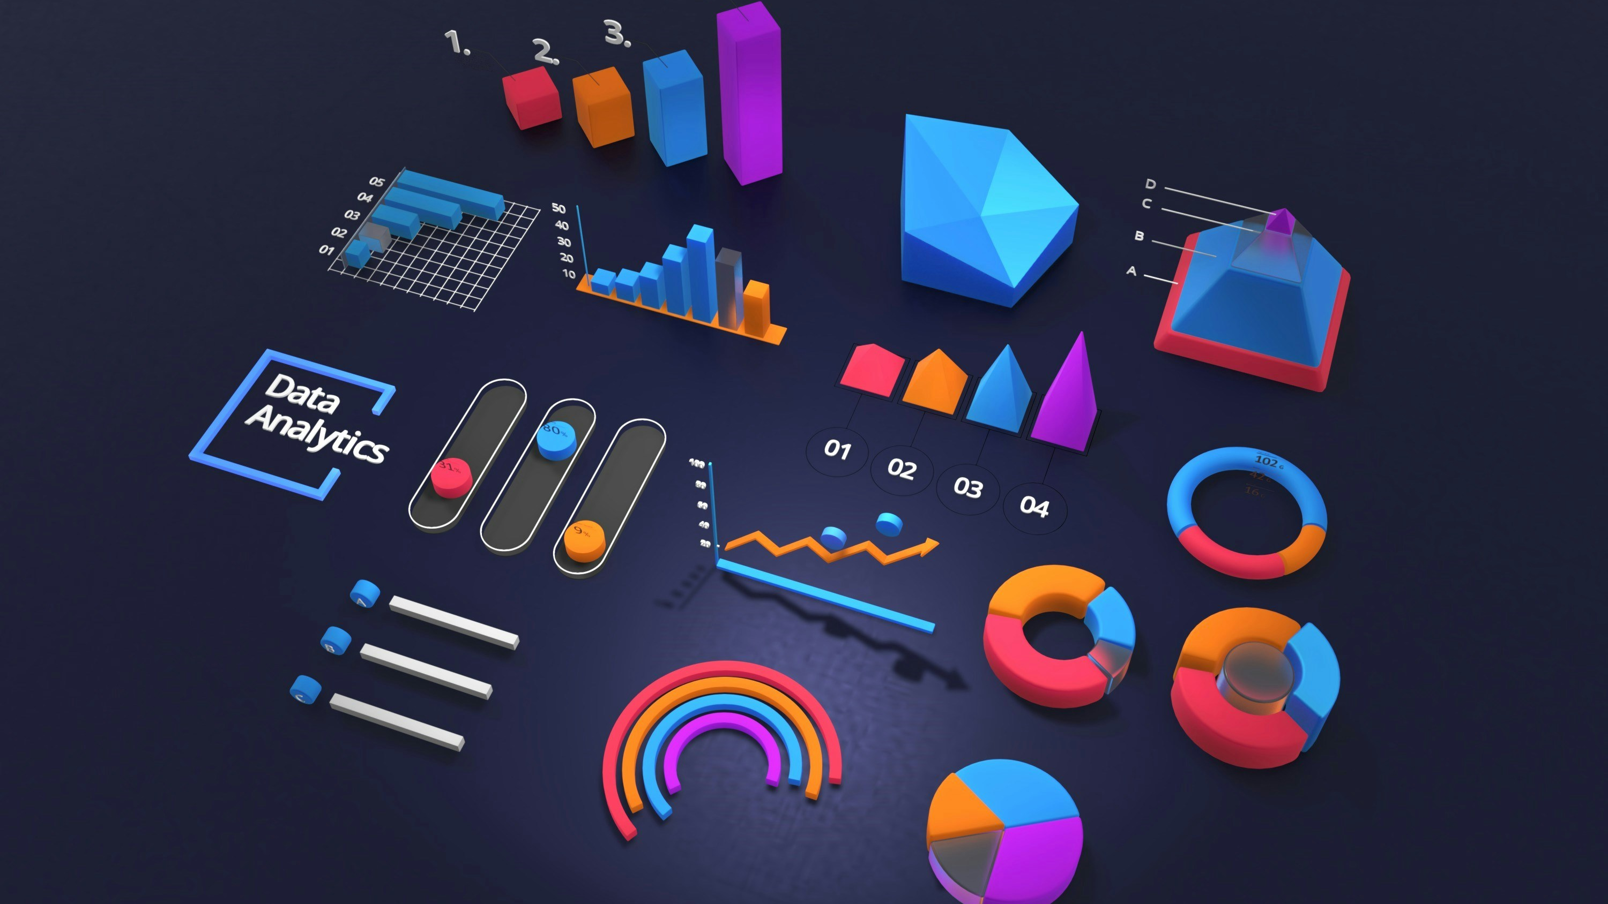
Data-Driven Decisions
Measurable Results
This comprehensive analysis transforms raw transaction data into strategic business intelligence. By leveraging Python, SQL, and Power BI, we've uncovered actionable insights that enable personalized marketing, optimized pricing, and enhanced customer experiences.
Data-Driven
Actionable
Impactful
3,900 transactions analyzed across 18 dimensions
5 strategic pillars for sustainable growth
25-30% projected revenue growth
The path forward is clear: implement these recommendations to drive revenue growth and build lasting customer relationships.

